Slide 1


Buckeye Council Popcorn University 2026
Let’s Play… Pop to the Top!

Slide 2


Welcome to Pop to the Top! The game show where each week throughout the sale, your Scout can be entered to win a variety of prizes! Every Thursday, we will go live on our Facebook page and draw a winner,
and the premise is simple, sell the required amount, upload your sales sheet for verification, then you are entered to win that week's prize!
Forms uploaded to the same link as the All-Out Blitz
All submissions must be received by 11:59pm on the date they are due.

Slide 3




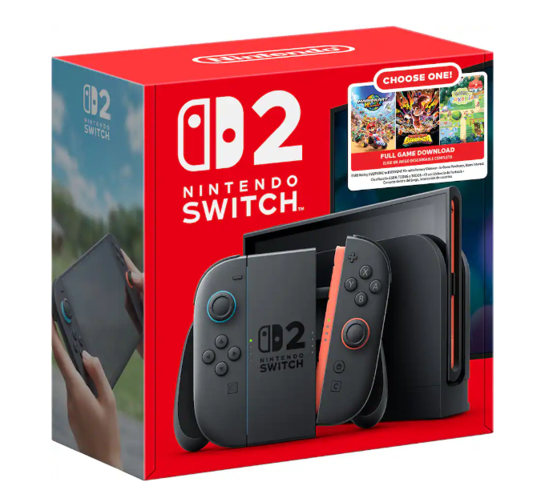




Week 4 – Scouts that sell $400 by 10/5 will be entered to win a Meta Quest 3S.
Week 5 – Scouts that sell $600 by 10/12 will be entered to win a Nintendo Switch 2 “Choose Your Game” Bundle.
Week 6 – Scouts that sell $700 by 10/19 will be entered to win an Xbox Series X.

Slide 4


5 additional runners-up each week will get to pick from the “Prize Vault”!
Any Scout that achieves all levels by 10/19 will automatically be entered for the All-Out Blitz!

Slide 5
A Unit Kickoff is the best way to get parents and kids excited!
Use the “Pop to the Top” game show theme.
Make this a pack meeting activity.
There is a full agenda and planning information on pg. 44 & 45 of your guidebook!
Our enthusiasm becomes the kid’s enthusiasm so be intentional and make it silly and fun.

Slide 6





Highlight what the kids will receive if they hit the $700 level…
Sell $400 = Entries to win =
Sell $700 = Plus Prizes =
$40 Gift Card

Slide 7

The parents will make the decision on whether to sell or not, so make it worth their time too…
Pack 1034 developed this tiered system to show exactly what is in it for parents.

Slide 8



What’s New in 2026?
Freedom Pretzels
These limited-edition Red, White, and Blue pretzels are the perfect sweet and salty mix!
America 250 Tin
This limited-edition tin is filled with last year’s new flavor, Mountain Munch!
Cinnamon Roll
A sweet, buttery blend of cinnamon and sugar!

Slide 9
Key Dates for the Sale
7/1 – Online Store Opened
9/7 – Show and Sell Orders Due
9/18 & 9/19 – Show and Sell Delivery (Locations Vary)
9/17 – Pop to the Top First Drawing
9/19 – All Out Blitz Begins
10/5 – All Out Blitz Ends
10/22 – Pop to the Top Final Drawing
10/29 – Unopened Cases Return (West @ Gorman Rupp)
11/2 - Unopened Case Return (East @ Total Distribution)
11/2 – Take Order Due by 11:59pm
11/2 – Prize Order Due by 11:59pm
11/13 & 11/14 – Take Order Distribution (Locations Vary)
11/20 – Late Orders Due by 11:59pm
11/20 – Online Store Closes
12/4 – Payments Due to Buckeye Council Offices
12/4 – Late Order Delivery to Buckeye Council Office (Canton Only)

Slide 10


?

Slide 11
Thanks for Attending!

