Slide 1
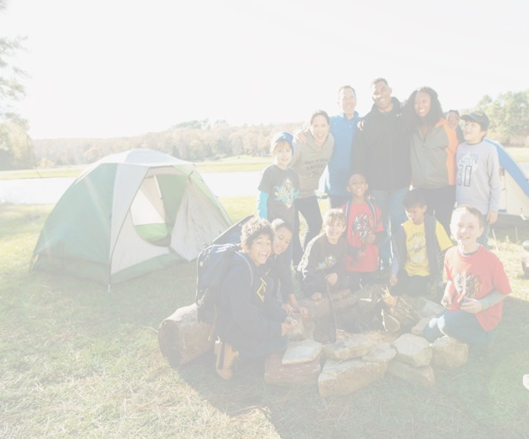
Getting The Message Out
Reaching every youth with the message of Scouting requires informing and inspiring people to consider the value of Scouting to themselves and the community.
Message to Schools
Communicating to principals and teachers the benefits that your pack brings to the school is a critical part of partnering with them. This ensures every family learns about Scouting as a great tool to shape the lives of their children for the future.
Message to Parents
Parents and guardians are the decision makers when it comes to the activities their children will join. We must continually tell and re-tell couples, single parents, and other influencers about Scouting’s promise to give their children advantages in life.
Message to Kids
Kids want to join Scouting because it’s FUN! Keep the “fun and adventure with friends” in front of them at all times to create an insatiable desire to be a part of your pack.
Message at Join Scout Night
When you hold your recruiting event at school, you are on familiar ground for parents and youth. Being organized, informative, enthusiastic, and fun will create for them the confidence to join and get involved.
Reaching Every Family
Design a Plan that Shows You Care About Reaching Every Family
We are providing a variety of tools to help you recruit the most Cub Scouts. The more active recruitment methods we use, the more successful we will be. We are looking forward to our partnership with you as we grow Scouting together. Thank you for your support!
Step-by-Step Plan:
How to Grow Scouting
Use this resource to help recruit more kids. By using all of the recruitment items, your pack will grow. Selecting someone to be responsible for each task will help make small work of recruiting new Cub Scouts. Please write the name of the person responsible for each task and an estimated completion date. Commit to completing all tasks to ensure your success. Utilize the list of key actions and additional actions to enhance this plan.
PACK LEADERSHIP Key Actions
Recruitment Events
Join Scout Night Recruitment Event
Parent Orientation
Second Chance Join Scout Night
Active Promotional Tactics
Yard Signs at Targeted Locations: __________________________________________________________________
Buddy Cards
Flyers / Posters
Update your BeAScout.org Unit Pin & Online Registration
Have an up-to-date Pack Calendar
School Open House participation
DISTRICT LEADERSHIP Key Actions
Principal Visit
Join Scout Night Flyer (one week prior to JSN)
School Talk & Flyer
Buddy Cards
Yard Signs
PACK LEADERSHIP & SCOUT FAMILIES Additional Actions
Select 2-3 items your pack will commit to this year
Uniform Day at School
PTO / PTA Presentation
School Newsletter
Peer-to-Peer Recruitment (Buddy Cards)
Call Families Who Dropped from Charter
School Talk at Sunday School / VBS
Community Rally (YMCA, Library, Fire Dept.)
Thank Your Principal at your Blue and Gold Banquet
Press Release Announcing your Pack’s Join Scout Night
Announcements in Church Bulletin
Have a Functional Website with your Pack Calendar
Post your Packs Join Scout Night on Facebook
Bring A Friend to Camp
Hang Flyers around Town about your Pack / JSN
Open House photo booth
Assign someone to be your New Member Coordinator
Do a Good Turn for your elementary school
Who’s on your team?
1. Develop membership plan with District Executive _____________________________
2. Principal visit with District Executive ______________________________________
3. School Open House participation
______________________________________
4. Join Scouting flyer (first day flyer) sent home during the first week of school
______________________________________
5. School Talk Help: 1-3 days before JSN
______________________________________
6. Parent-to-Parent campaign ______________________________________
7. Join Scout Night Coordinator ______________________________________
Additional Actions:
______________________________________
______________________________________
Name Estimated Completion Date
Name Estimated Completion Date
Name Estimated Completion Date
Name Estimated Completion Date
Our Pack’s Plan to Reach Every Kid in __________________ School throughout 2020.
Pack Number: _____________ Current Members: ________________
Name Estimated Completion Date
Regular Meeting Information: ________________________________________________________________________________________
Pack Join Scout Night Date: ___________________
Parent Orientation Meeting Date: _______________
Second Chance Date: ________________________
Signed (Cubmaster or Pack Committee Chair) Date
Signed (District Executive) Date
Signed (District Membership Chair) Date
Name Estimated Completion Date
 | Kindergarteners | 1st Graders | 2nd – 5th Graders | Total Cub Scout Recruitment Goal
2019 Recruited
2020 Goal to Recruit
Name Estimated Completion Date
Pack leaders to receive copy of recruitment plan:
___ Key 3 ___ All Den Leaders ___ All Committee Members

Slide 2
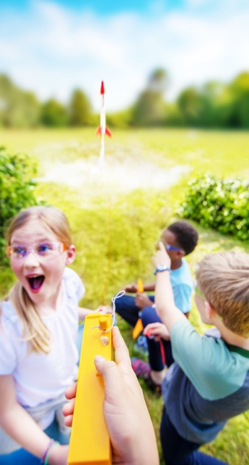
2020 Lion & Tiger Hunt
The Scouting Adventure
Begins with You!
- LIONS -
Recruit the best Lion Den Leader(s) by May 15
Set up a recruitment table at incoming Kindergarten registrations in the spring
- TIGERS -
Join Scout Night flyer sent home one week before Join Scout Night
Conduct school talks to current kindergarteners
Hold Join Scout Night Recruitment event by May 15
Recruit and train the best Tiger Den Leader by May 31
Conduct a Parent Orientation and Day Camp Info session one week after Join Scout Night
Ensure Tiger den is meeting 2-3 times a month during the summer
Every kid needs Scouting’s values: life-changing, life-directing character traits, decision making abilities, leadership skills, habits of service to God and service to others. Every kid deserves to experience good in life and to help others find it too. And YOU are the key. Because you give time and effort to Scouting, kids in your pack will have advantages in life they may not otherwise have. Compared to their non-Scout peers, Scouts grow up to:
Perform better in school, graduating from high school and college at a much higher rate
Be more financially responsible, attain higher incomes and ownership
Report higher confidence in their abilities and satisfaction with their lives
Value and practice their faith more consistently
Give more back to their communities through acts of service and charitable giving
However, youth will not get all that you and Scouting have to offer if they don’t join. It all starts with giving every kindergarten through fifth grade kid the opportunity to join Cub Scouts. You can reach out to every Cub Scout-aged youth in the community you serve. Your district membership team can help. TOGETHER, we can inform and inspire parents and kids to join your pack and start their journey toward Arrow of Light, Eagle Scout and community leader. They may not know it yet, but they are depending on us to compel them to become Scouts. We must not let them down.
Melissa Biltz, Council Membership Chair
Boy Scouts of America, Buckeye Council
www.buckeyecouncil.org
2020 Spring Recruitment Timeline
Pack Join Scout Night Date: ____________________
Parent Orientation Meeting Date: ________________
Second Chance Date: _________________________
Signed (Cubmaster or Pack Committee Chair) Date
Signed (District Executive) Date
Signed (District Membership Chair) Date
Delivering the Promise
Cub Scout Packs benefit by encouraging activities during the summer. Plan one event each month to keep your Scouts active during their summer break.
Does your pack attend and promote Day Camp or Cub Scout Summer Camp?
YES
NO
Does your Pack have a program in July and August? Even a simple program (parade, summer picnic, etc.)
YES
NO
Has your pack ever earned the Summertime Pack Award?
YES
NO
Does your Webelos Den work with the local Scout Troop to ensure crossover before Summer Camp?
YES
NO
Would your pack be willing to organize a spring and fall recruitment
effort utilizing the plans in this document?
YES
NO
Does your pack attend and promote Fall Family Adventure Camp?
YES
NO
2020
CUB SCOUT
GROWTH PLAN

