Slide 1


Welcome to E.A.R.S. Hero Training
Popcorn University 2025

Slide 2

content…
E.A.R.S. Academy
03
Your Mission
01
04
What’s New?
02
Locate the E.A.R.S.
05
Questions?

Slide 3


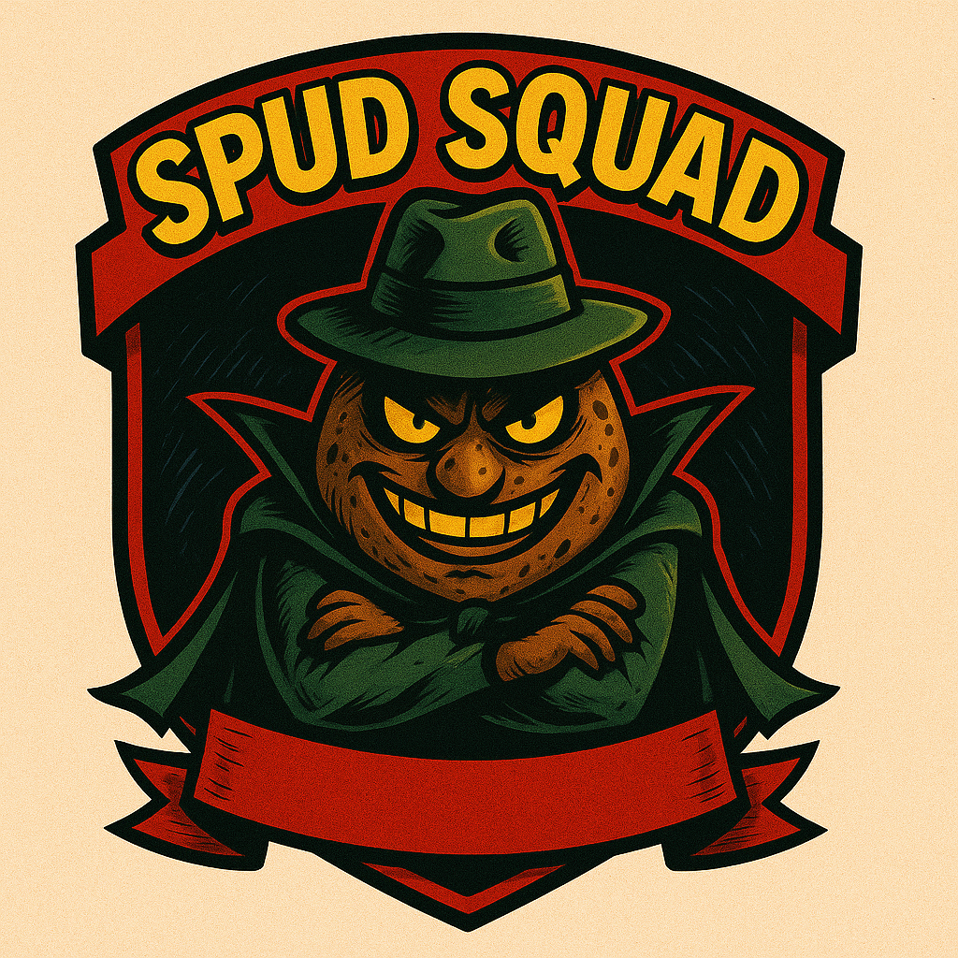
Your Mission!
The Spud Squad is trying to replace all popcorn snacks with potato chips. We cannot allow this to happen. The people need access to quality corn snack products!
We need heroes! Take this year’s snack lineup into your community. Go door-to-door or set up a table. We must keep the spud squad at bay and continue to fund our operations!
01
Across the Snackerverse

Slide 4
You will GET:
Fall Campout - $25
Summer Camp - $50
Pinewood Derby - $10
All Awards: $50
Raingutter Regatta: $10
Christmas Party: $10
Halloween Party: $10
Rubber Ducks Game: $25
Blue & Gold Banquet: $15
If We Succeed
Total = $205
$205 x 3 = $615 in popcorn sales to succeed the mission!
Round UP to $700 to reach the All-Out Blitz Level
01

Slide 5


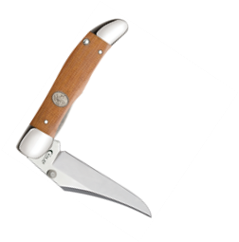
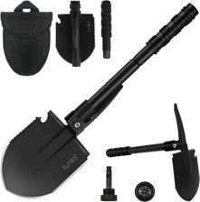
Sell $400
$20 Gift Card
Hit a Blitz Level to keep the Spud Squad at bay… and get prizes
Sell $700
$40 Gift Card
Sell $1,000
Switch 2 Drawing
Plus Prizes!!!
01

Slide 6


=
Locate Fellow E.A.R.S. Agents and Secure a switch 2!
Scouts will be searching door to door for fellow E.A.R.S. Heroes while working toward their goal in search of 4 Nintendo Switch 2’s
01
Clues will be distributed weekly via the What’s poppin’? Newsletter

Slide 7



E.A.R.S. Academy
Building the Perfect Seller
Clear Targets
Set Clear Targets on what you need to sell to achieve your goal!
Materials + Timeline + Goal = Mission Achieved
Having a Unit Kickoff is Mission Critical!
Engages Parents & Families
Let Mom & Dad Know what it’s going to pay for and let the kids know what prizes they will get!
03

Slide 8
Unit Kickoff 101
Building the Perfect Seller
Our enthusiasm becomes their enthusiasm!
Be Intentional About it and make it fuN!
The best way to improve your sale is by having an excellent unit kickoff!
Don’t wait to do a kickoff! The Sale Starts now!
03

Slide 9



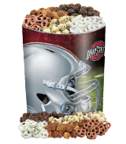
What’s New in 2025?
New Military Themed Tin!
Maple Pecan is now in a new military themed tin! Perfect for sales at your local VFW or American Legion or for your unit to purchase and deliver or ship to veterans or those stationed overseas!
New Flavor-mOuntain Munch!
Mountain Munch is a Classic Caramel corn with roasted pecans, almonds, and cashews then drizzled with melted chocolate!
Chocolate lovers will be in an OSU National Championship Tin!
This year, chocolate lover’s will be in an exclusive OSU National Championship tin to celebrate the buck’s Championship in 2024! Show your buckeye pride this fall with a one-of-a kind tin, perfect for game days, tailgates, or gifts!
04

Slide 10

Questions?
05

Slide 11

THANKS FOR Attending!
TO BE CONTINUED…

